Slide 1
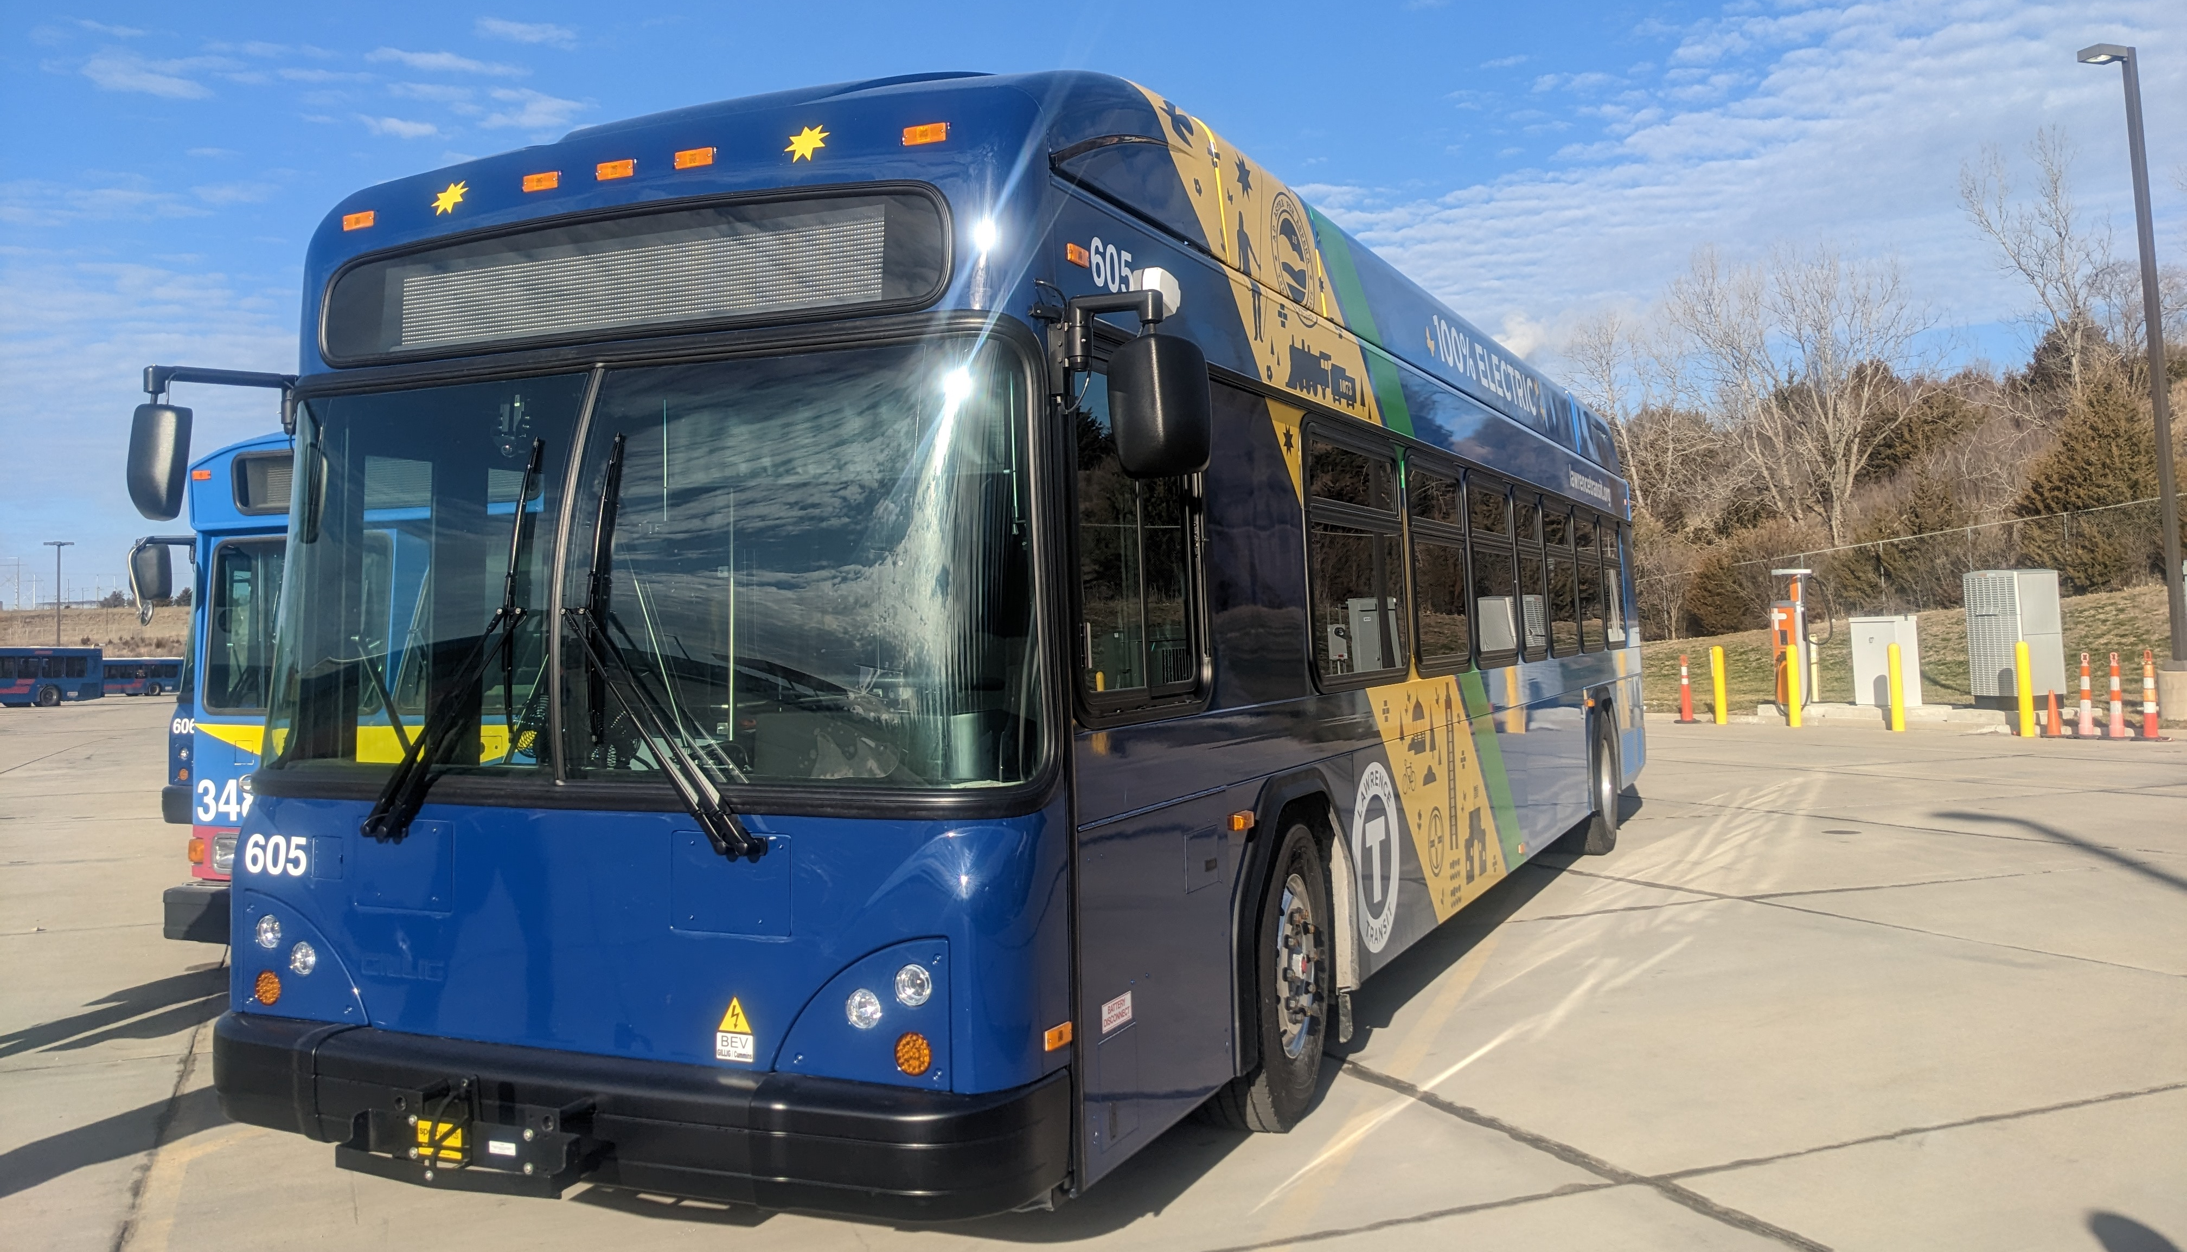
Lawrence Transition Plan -
Fixed Route Fuel Assessment DRAFT
Steve Clermont, Senior Managing Consultant/Director of Planning & Deployment
Maggie Maddrey, Managing Consultant
Rebecka Moreno, Lead Engineering Associate
Shannon Russell, Lead Managing Associate
Center for Transportation & the Environment

Slide 2
Fleet Transition Methodology

Slide 3
Zero Emission Transition Scenarios
Fixed route ZEB scenarios being considered:
  BEB Depot Only (overnight charged BEBs)
  BEBs w/ opportunity charging (using higher powered opportunity chargers on-route)
  Mixed Fleet (overnight charged BEBs + FCEBs)

Slide 4
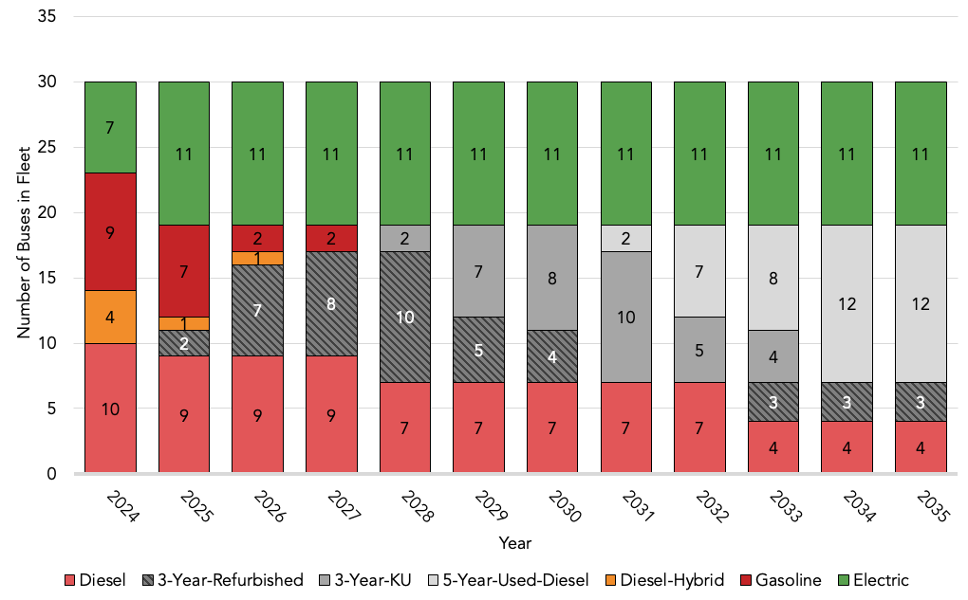
Fleet Composition Projection
Baseline
In 2035, 30 vehicles:
  11 electric
  19 ICE
37% BEB / 63% ICE

Slide 5
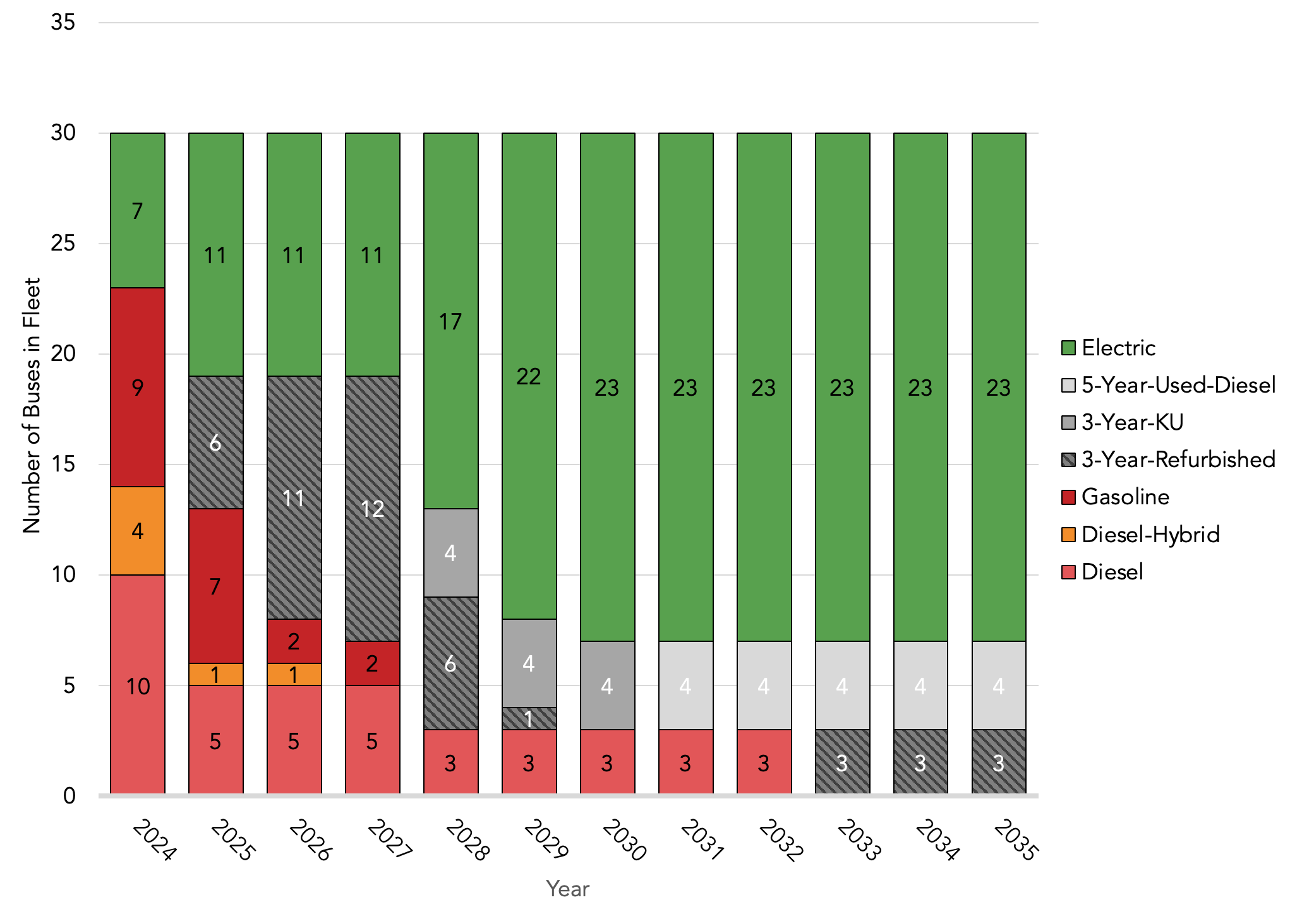
Fleet Composition Projection
ZEB Scenario 1 – BEB Depot Only
In 2035, 30 vehicles:
  23 electric
  7 ICE
  77% BEB / 33% ICE
Notes:
Refurbish diesel hybrid in 2027 for 3 years then make electric.
Don’t transition just 1 vehicle. Try to consolidate procurements so just have a couple of big grant purchases. Maybe shave off a few years of refurbishment
Add note about years where just 1 electric procurement.

Slide 6
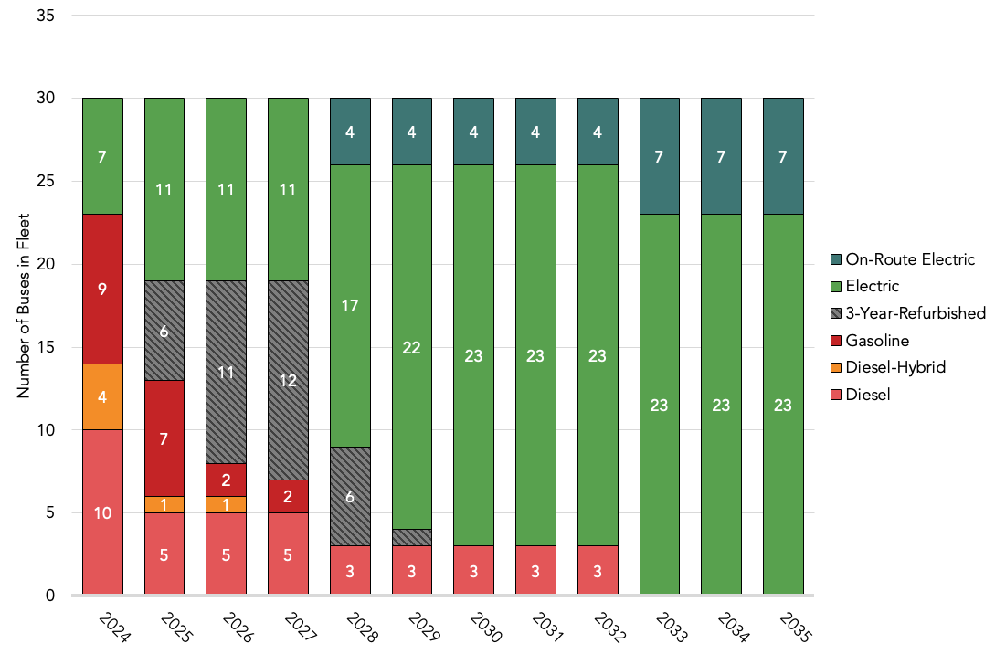
Fleet Composition Projection
ZEB Scenario 2 – BEB Depot and On-Route Charged BEB
In 2035, 30 vehicles:
  23 electric
  7 on-route electric
  100% ZEB

Slide 7
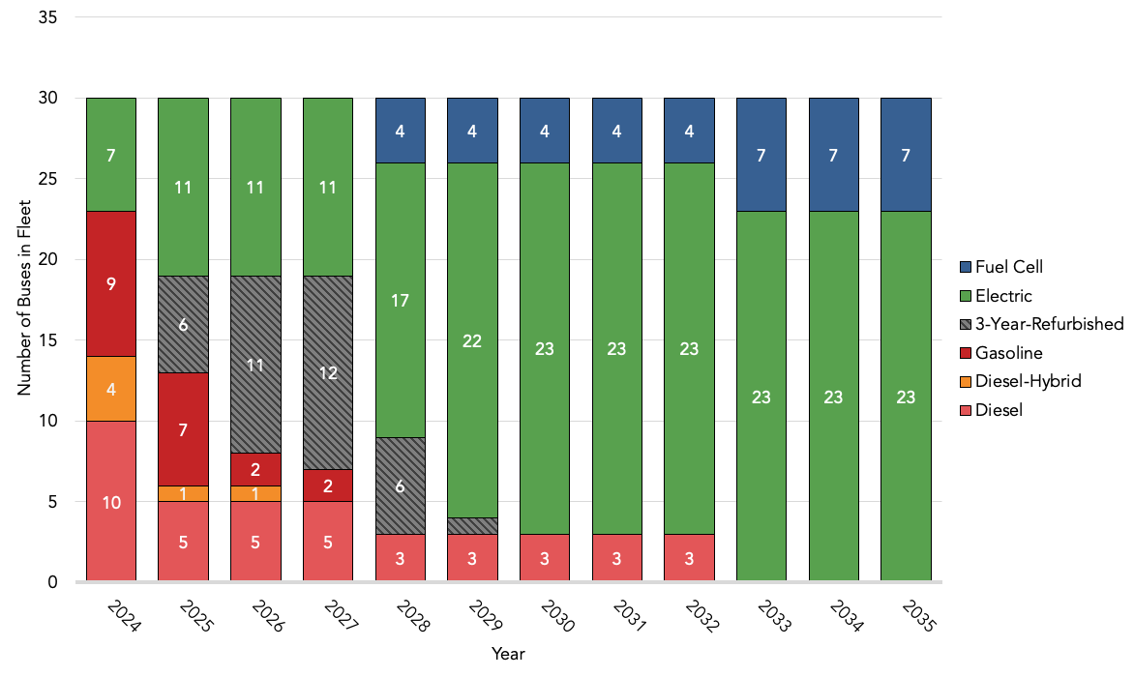
Fleet Composition Projection
ZEB Scenario 3 – Mixed BEB and FCEB Fleet
In 2035, 30 vehicles:
  23 electric
  7 fuel cell
  100% ZEB

Slide 8
Fuel Assessment Overview
Estimate zero-emission vehicle fuel costs

Slide 9
Fuel Assessment Assumptions: General
Fuel Consumption
  Annual mileage and fuel use is constant for all vehicles through 2035, based on current fleet averages
    FCEB fuel use is calculated with CTE fuel efficiency assumptions [mi/kg]
      20% hydrogen-related losses through venting and transportation are taken into account
    BEB fuel use is calculated with CTE fuel efficiency assumptions [kWh/mi]
      80% charger efficiency assumed
Fuel Costs
  All fuel costs are escalated using EIA’s 2022 Annual Energy Outlook 2024-2050 average annual change
    ICE
      Diesel and Diesel Hybrid: $3.13, based on current Lawrence Data [4/1/2024]
      Gasoline: $2.72, based on current Lawrence Data [4/1/2024]
    Hydrogen
      $9/kg, estimate based on regional off-site, trucked-in hydrogen current costs.
      Additional sensitivity analysis provided for the Mixed scenario, to project a reduction in hydrogen costs by 3% YOY beginning in 2026 – assuming infrastructure has been built out for regional hydrogen production.
    Electricity
      Electricity costs are based on Evergy’s Electric Transit Service (ETS) rate.
Rate Schedule | TOU | Fixed Fees | Energy Rate [$/kWh] | Energy Surcharges [$/kWh]
Evergy Electric Transit Service | On-Peak 6:00 AM – 6:00 PM | $32.47 | $0.15543 | $0.051538
 | Off-Peak: 6:00 PM – 6:00 AM |  | $0.02278
Notes:
nominal efficiencies should be utilized in cost modeling as these values represent annual average energy use

Slide 10
Fuel Assessment Assumptions: General
Charger Maintenance costs are included in fuel assessment to reflect total cost of charging and operation
  Depot charger maintenance cost estimated at $3,000/yr/charger
  Pantograph/Inductive charger maintenance cost estimated at $7,500/yr/charger

Slide 11
Fuel Assessment Assumptions: BEB Charging
Baseline Analysis includes already installed depot chargers
BEB Depot-Charging Analysis includes already installed depot chargers and future purchases as BEB-fleet increases:
  Depot-charging rate assumption: 200 kW
  No depot-charging during on-peak hours
  Charging ratio assumption: 1 charger : 3 buses
On-Route-Charging Analysis includes already installed depot chargers, projected additional depot chargers and pantograph/inductive chargers as On-Route-BEB-fleet increases:
  Pantograph/Inductive charging-rate assumption: 350 kW
  All on-route-charging occurs during on-peak hours – 85% on peak/15% off peak
  No depot-charging during on-peak hours
  Charging ratio assumption: 1 charger : 4 buses
Notes:
Assume 15 minutes per bus for charger.
Assumes all on-route charged buses charge at the depot and only use the on-route stations for the additional energy required to complete their routes

Slide 12
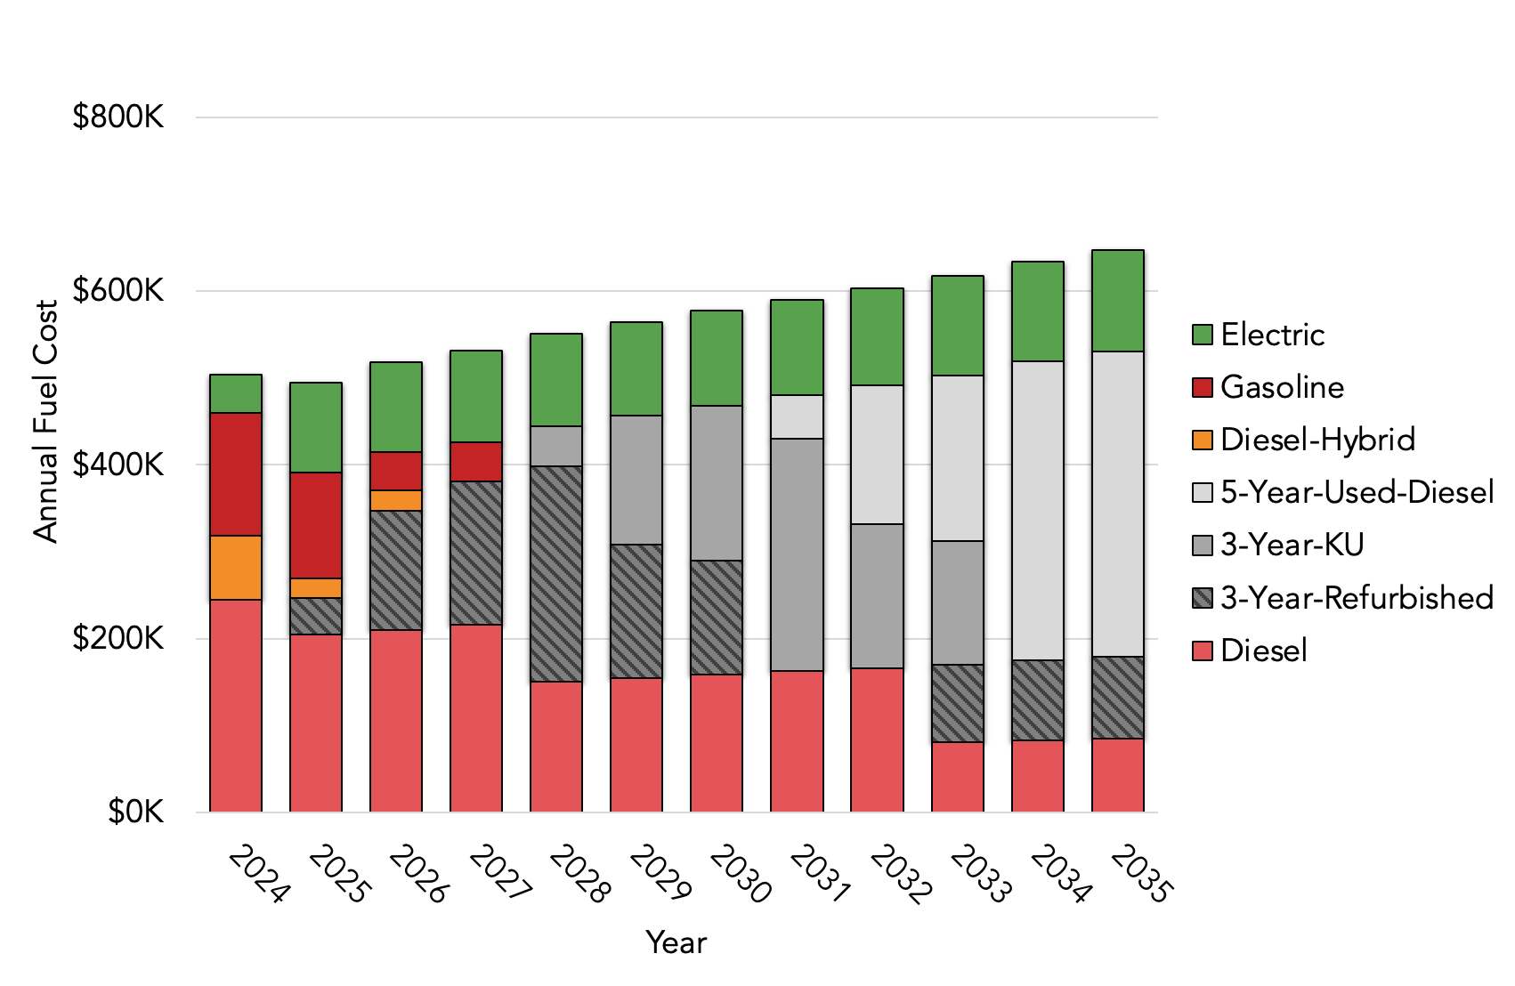
Annual Fuel Costs by Fuel Type
Baseline
$6.8M total expenditures 2024-2035

Slide 13
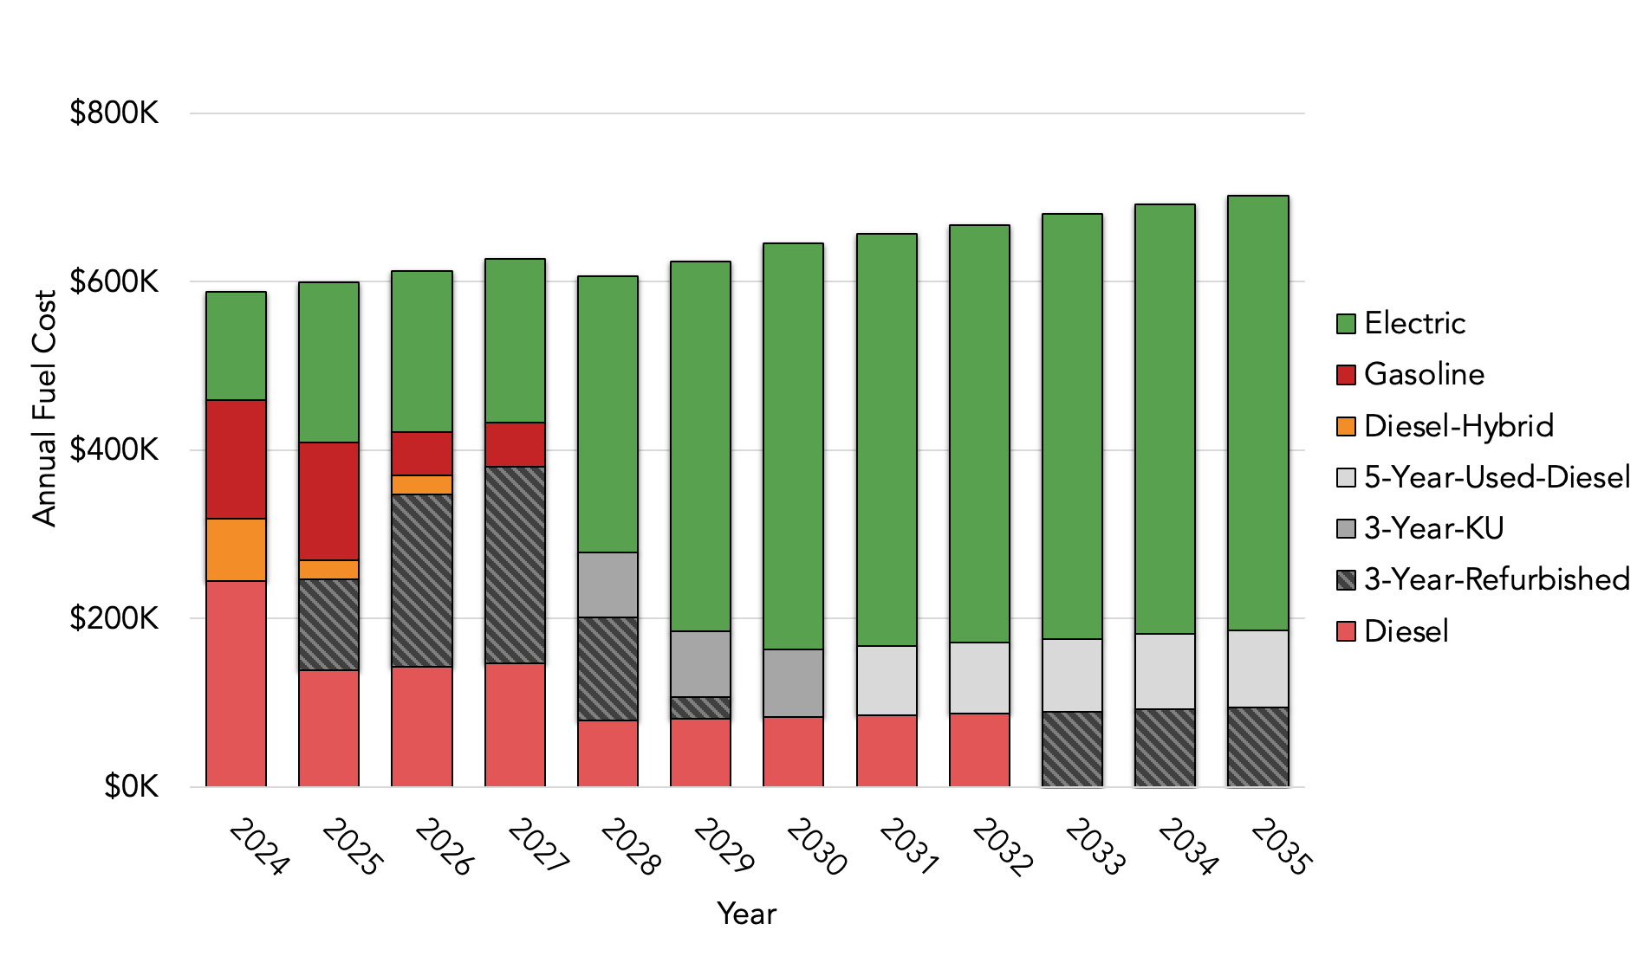
Annual Fuel Costs by Fuel Type
ZEB Scenario 1 – BEB Depot Only
$7.7M total expenditures 2024-2035

Slide 14
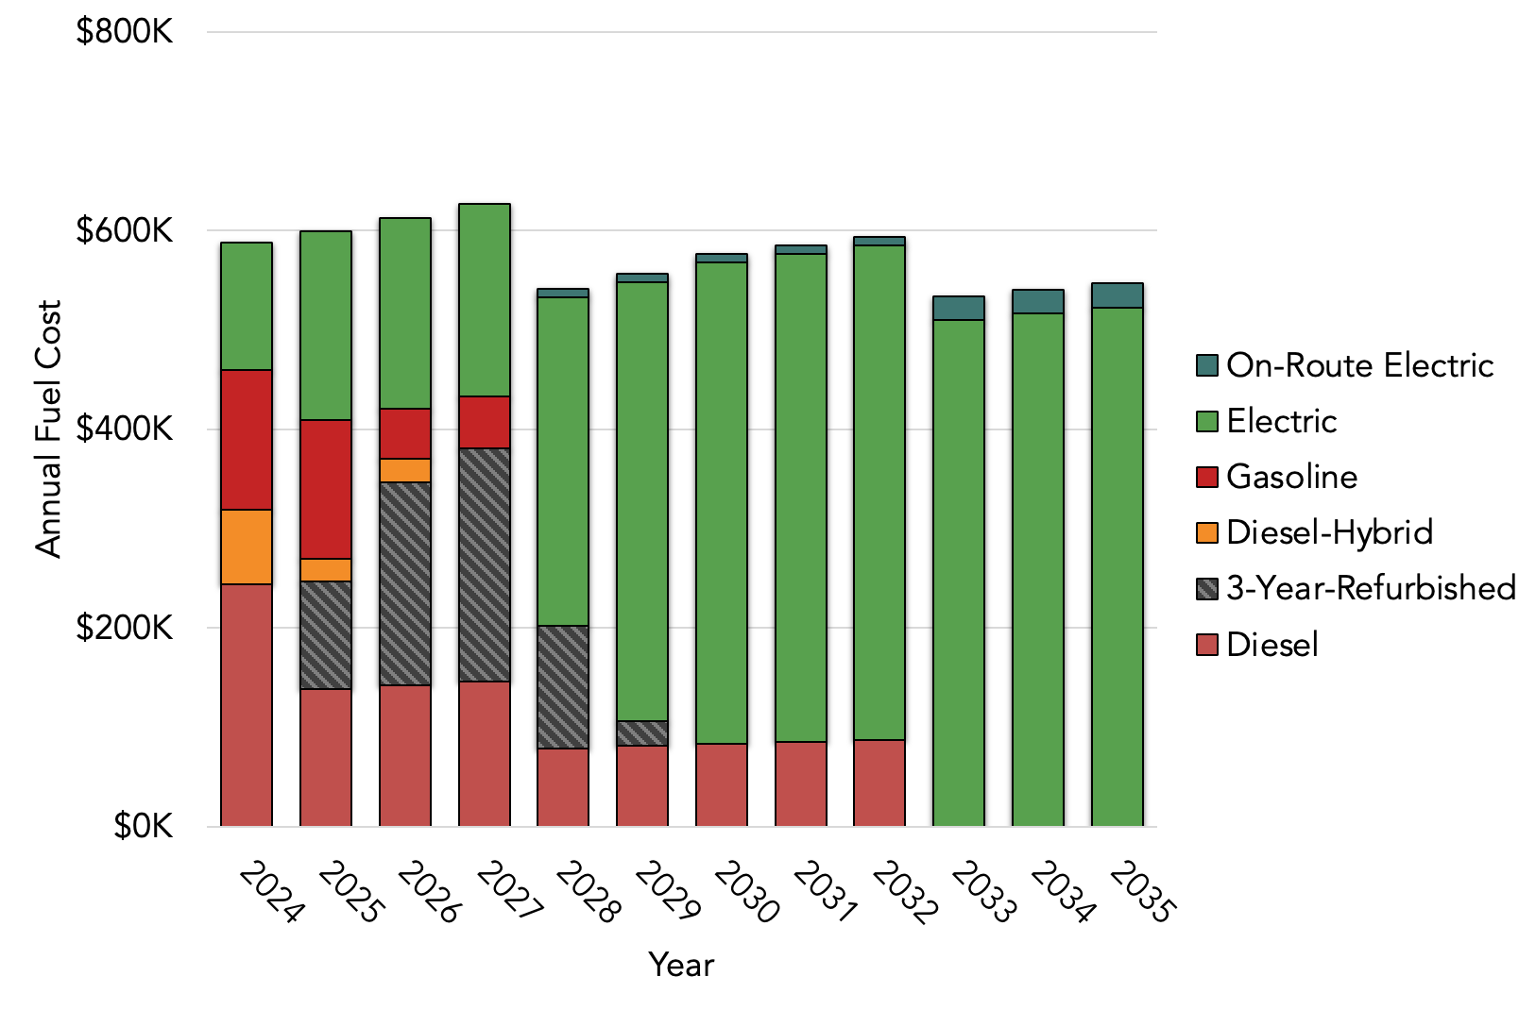
Annual Fuel Costs by Fuel Type
ZEB Scenario 2 – BEB Depot and On-Route Charged BEB
$6.9M total expenditures 2024-2035

Slide 15
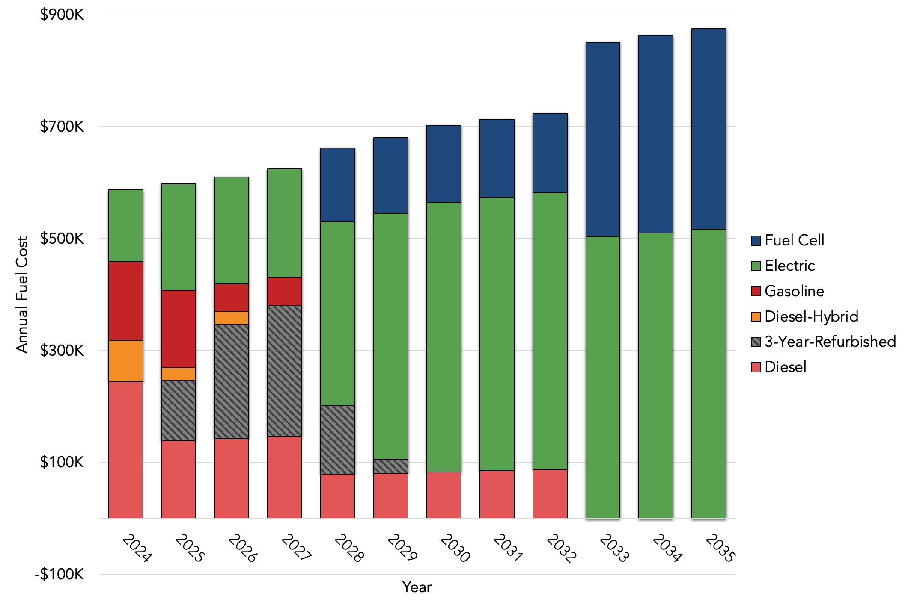
Annual Fuel Costs by Fuel Type
ZEB Scenario 3 – Mixed BEB and FCEB Fleet
$8.5M total expenditures 2024-2035

Slide 16
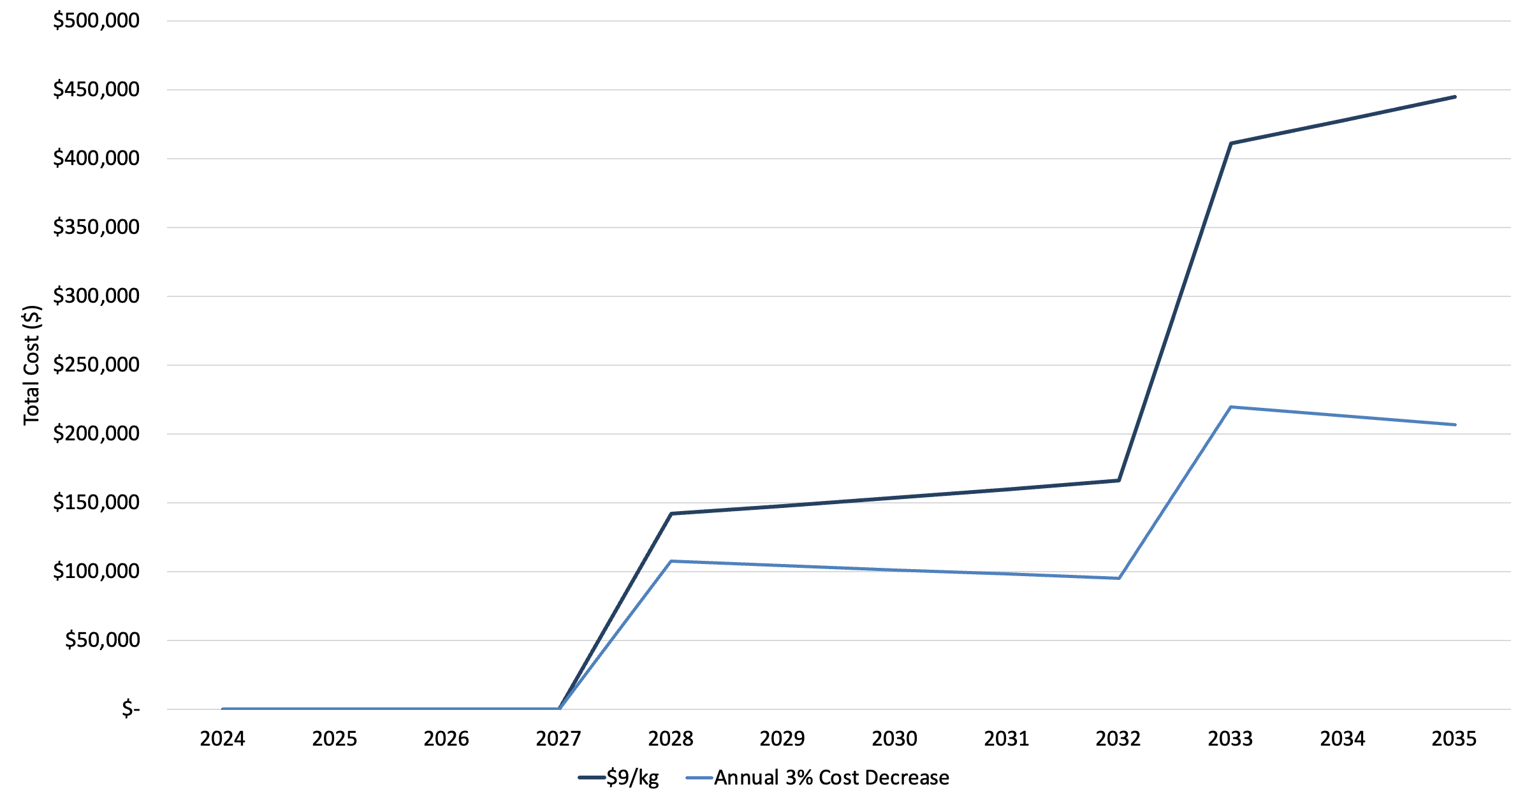
Hydrogen Cost Sensitivity
ZEB Scenario 3 – Mixed BEB and FCEB Fleet
Hydrogen Cost | 2024-2035 Total
$9/kg | $2M
3% Annual $/kg Decrease | $1.1M
Difference | $2.1M

Slide 17
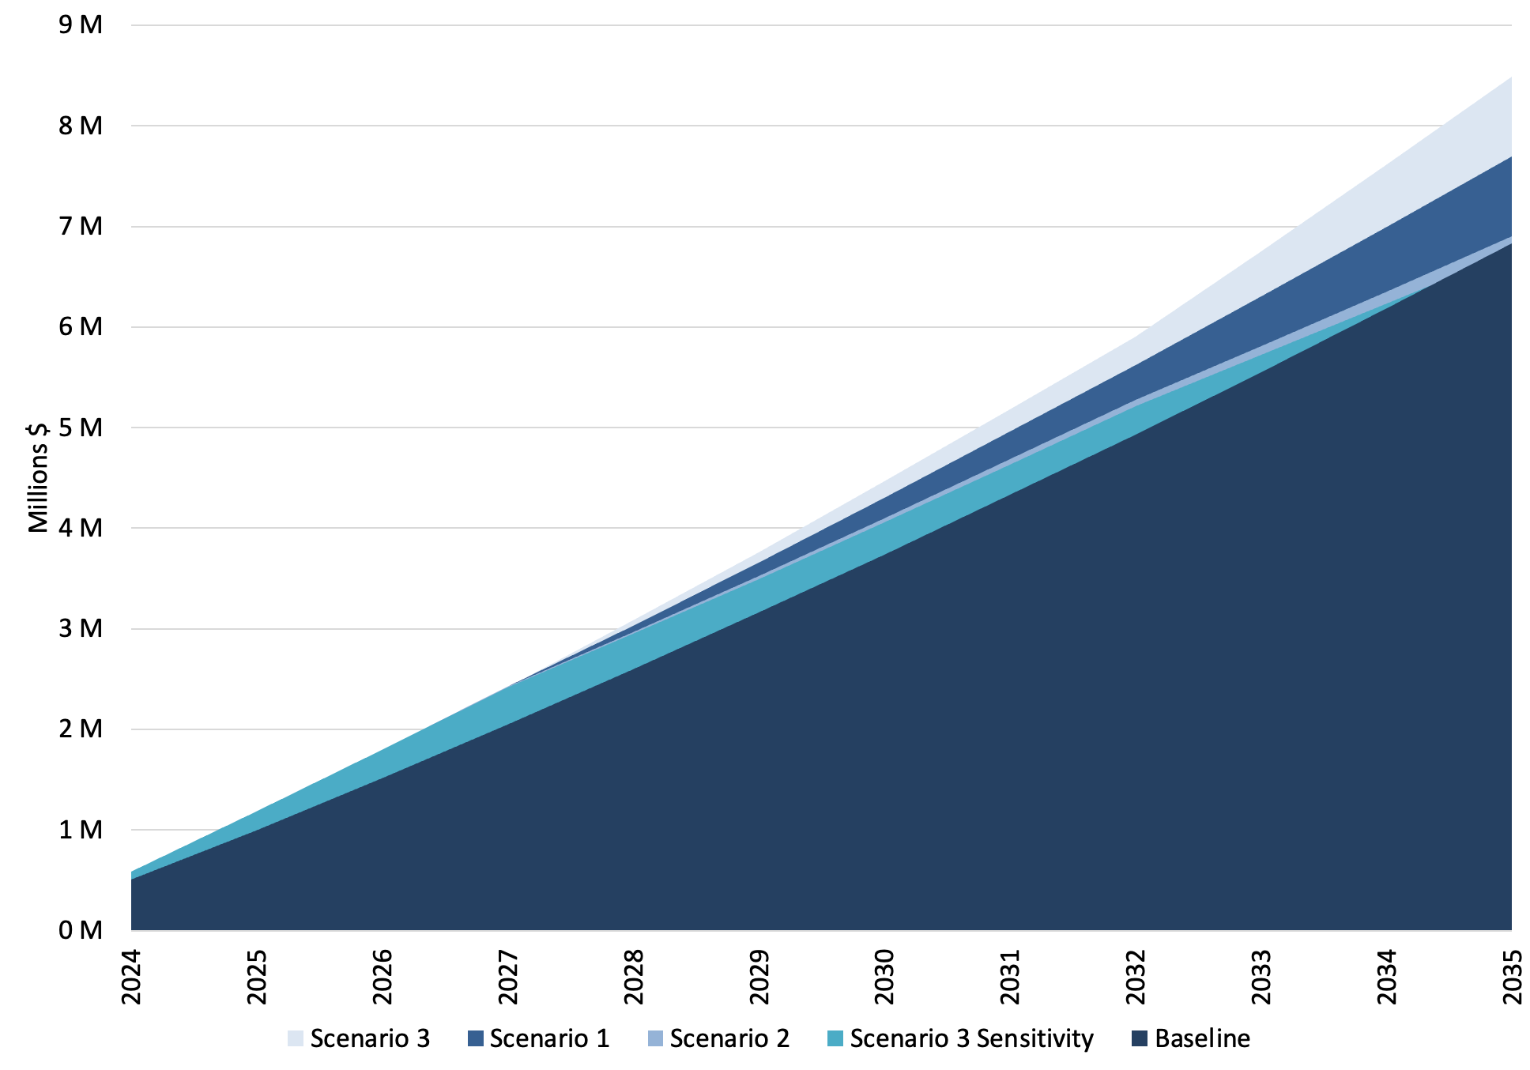
Cumulative Fuel Cost Comparison
All Scenarios
ZEB scenario’s total fuel costs are incrementally more than baseline.
Costs | Baseline | ZEB Scenario 1 (BEB Depot) | ZEB Scenario 2 (BEB Depot & On-Route) | ZEB Scenario 3 (BEB Depot & FCEB) | ZEB Scenario 3 Sensitivity
Cumulative ($) | $6.8M | $7.7M | $6.9M | $8.5M | $6.8M
Incremental over Baseline ($) |  | +$0.9M | +$69K | +$1.7M | -$83K
% ZEB Fleet by 2035 | 37% | 80% | 100% | 100% | 100%

Slide 18

Steve Clermont
SENIOR MANAGING CONSULTANT
DIRECTOR OF PLANNING & DEPLOYMENT
steve@cte.tv
Rebecka Moreno
LEAD ENGINEERING ASSOCIATE
rebecka@cte.tv
Shannon Russell
LEAD MANAGING ASSOCIATE
shannon@cte.tv
Maggie Maddrey
MANAGING CONSULTANT
maggie@cte.tv

Slide 19
Appendix
CPI
 | 2024 | 2025 | 2026 | 2027 | 2028 | 2029 | 2030 | 2031 | 2032 | 2033 | 2034 | 2035
CPI % Change | 4% | 4% | 4% | 2% | 2% | 2% | 2% | 2% | 2% | 2% | 2% | 2%
CPI Factor | 1.04 | 1.08 | 1.12 | 1.08 | 1.10 | 1.13 | 1.15 | 1.17 | 1.20 | 1.22 | 1.24 | 1.27
Fossil Fuel Factor | 1.03 | 1.05 | 1.08 | 1.11 | 1.14 | 1.17 | 1.20 | 1.23 | 1.26 | 1.29 | 1.33 | 1.36
Electric/H2 Factor | 1.02 | 1.04 | 1.05 | 1.07 | 1.09 | 1.11 | 1.13 | 1.15 | 1.17 | 1.20 | 1.22 | 1.24

Slide 20
Appendix
Performance
Bus Size (ft) | Nominal Efficiency (kWh/mi) | References
25 | 0.9 | Efficiency: CTE Aux Estimate (Lawrence Optimal CTE Model 2024)
30 | 1.7 | Efficiency: CTE Aux Estimate
35 | 1.9 | Efficiency: CTE Aux Estimate
40 | 1.9 | Efficiency: Lawrence KPI Data
Usable energy estimated at 80% of nameplate.
30’, 35’, and 40’ efficiencies used assume diesel heater.
Battery capacity increases 5% every two years based on anticipated technology improvements.

